Slide 1
Anatomic and Functional Analysis of a Large Scale Data Base of EVAR to address long term outcome failures
Adeline Schwein
Team : Thibault Kensicher, Toan Nguyen, Tuan Nguyen
Jean Bismuth, Nabil Chakfe, Marc Garbey
Notes:
the EVAR project, or “how can computer sciences and bio-engineering help the surgeon to deal with complications after endovascular aortic repair (EVAR)”.

Slide 2
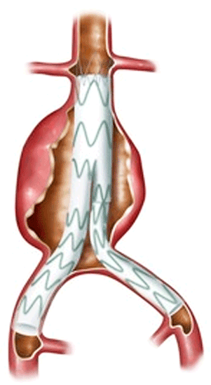
EndoVascular Aortic Repair : EVAR
2006 : 21 725 EVAR procedures in the USA¹
30 day mortality rate : 1.7% versus 4.7% after open repair²
But loss of early benefits over time due to postoperative complications :
  Stentgraft migration / rupture
  Endoleaks
  Sac enlargement (41% at 5 years¹) RUPTURE
5 years rupture rate : 3.2% after EVAR versus 0% after open repair³
1. Predictors of Abdominal Aortic Aneurysm Sac Enlargement After Endovascular Repair, A. Schanzer (2011)
2. EVAR trial participants. Endovascular aneurysm repair versus open repair in patients with abdominal aortic aneurysm : randomised controlled trial. Lancet (2005)
3. Rate and Predictability of Graft Rupture After Endovascular and Open Abdominal Aortic Aneurysm Repair, Data From the EVAR Trials. T Wyss (2010)
Notes:
EVAR means endovascular aortic repair, it is a treatment approach of abdominal aortic aneurysms. We have been using this technique for about 20 years now worldwide. It consists in deploying an endograft inside the aorta in order to exclude the aneurysm.
Since 2006, this technique has been more used than the conventional aortic open repair, mostly because of a reduced short-term morbidity and mortality rate. During that year, more than 20,000 patients have been treated with the EVAR procedure
The main issue remains a high rate of long-term complications which necessitate secondary intervention and which can lead to death. And this despite substantial improvements of aortic endografts over multiple generations.

Slide 3
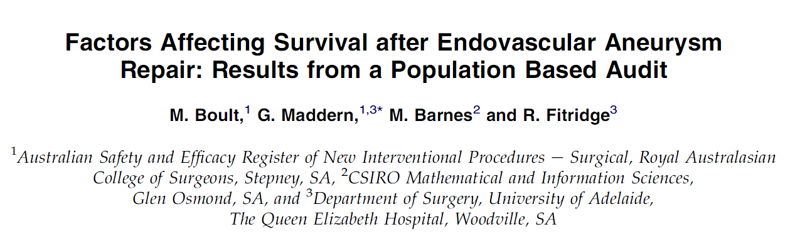
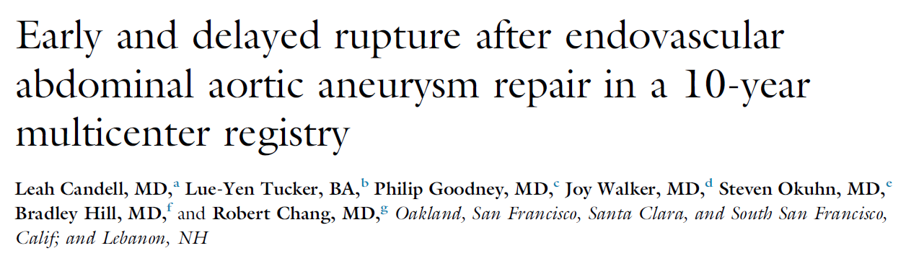
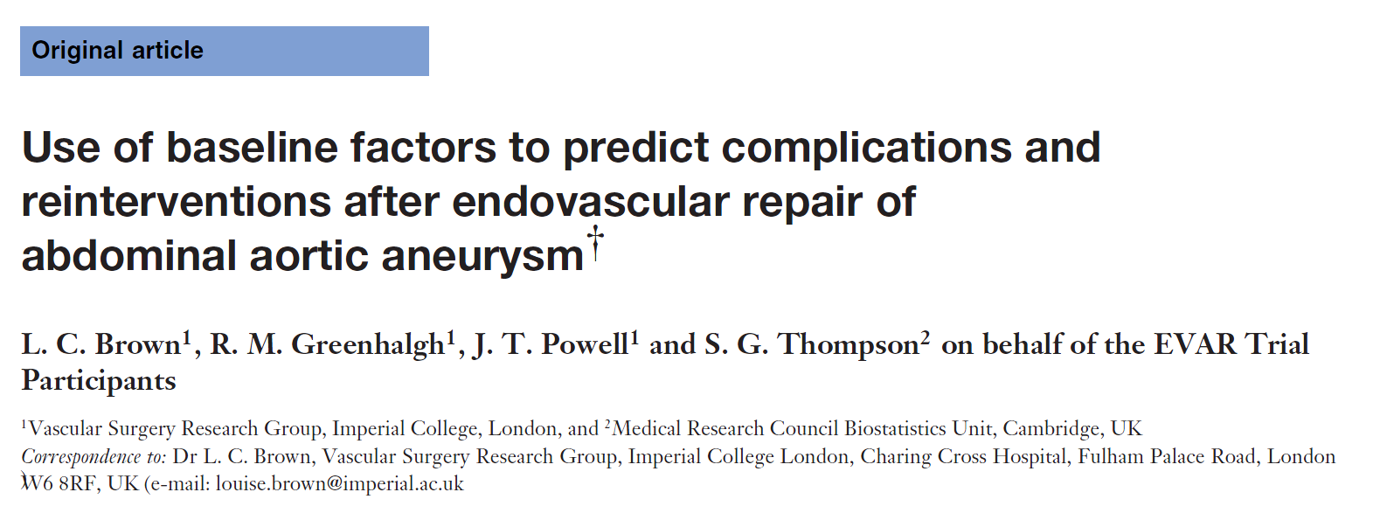
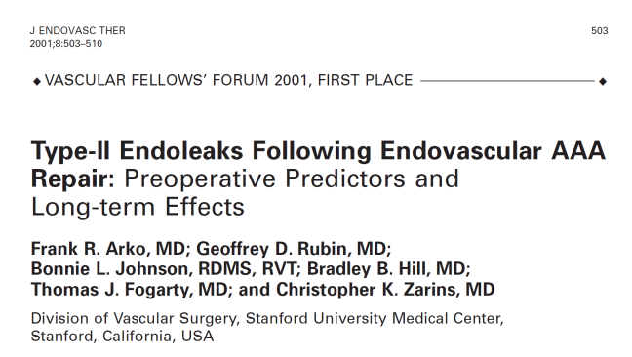
State of the art
Type II endoleaks ?
Stent migration ?
Stent fracture ?
Need of better understanding of interaction between the stentgraft and the aorta, regarding anatomical evolution and flow characteristics
Notes:
Of course many studies have been led to try to find predictors to these complications and we do know that some anatomical features are risk factors, but this is not enough to explain every poor outcome like stent migration or type II endoleaks which can appear up to 40% of the time after EVAR.
Nowadays we still have a poor understanding of the natural history of these complications and of the interactions between the endograft and the aorta: interactions regarding the evolution of the anatomy and flow characteristics.
We believe that the best way to acquire this knowledge and to be able to solve the long-term complications is to study the anatomical and functional changes of the system over time.
We will do this with a quantitative image analysis of each pre and postoperative CT scan.

Slide 4
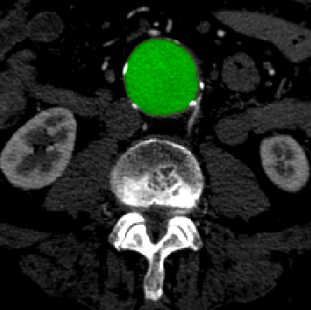
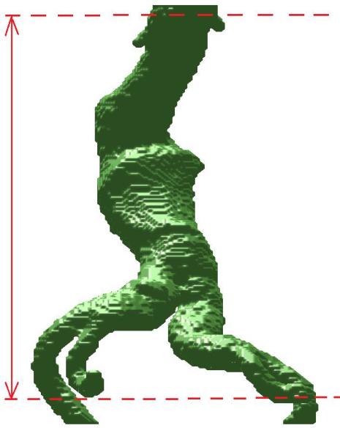
Goal 1 : automatic aortic segmentation
100% accuracy = impossible
Each algorithm has advantages and drawbacks
Objectives :
  Keep on elaborating and improving algorithms of segmentation
  Match each of them to specific aortic anatomy and characteristics
Be able to automatically analyze aortic features and to use the most suitable segmentation’s algorithm
Notes:
Our first goal is to provide a precise automatic aortic segmentation in order to build the most accurate 3D reconstruction from the CT slides.
Many teams are working on aortic segmentation, and nowadays many softwares do include an automatic segmentation of the aorta. But as you discovered it yesterday by experimenting yourself different algorithms, the automatic segmentation is not perfect, and will probably never be 100% perfect.
What you also learned yesterday is that each different algorithm has advantages and drawbacks and each may be more appropriate to different types of aortic anatomies.
So far, the computer scientists of our lab have been elaborating two main algorithms. Our objective is now to keep on developing different ways of segmentation and to be able to match each of them to a specific type of aortic anatomy or characteristics.
At the end of the day we would like to automatically be able to use the most suitable algorithm regarding the aortic features.

Slide 5
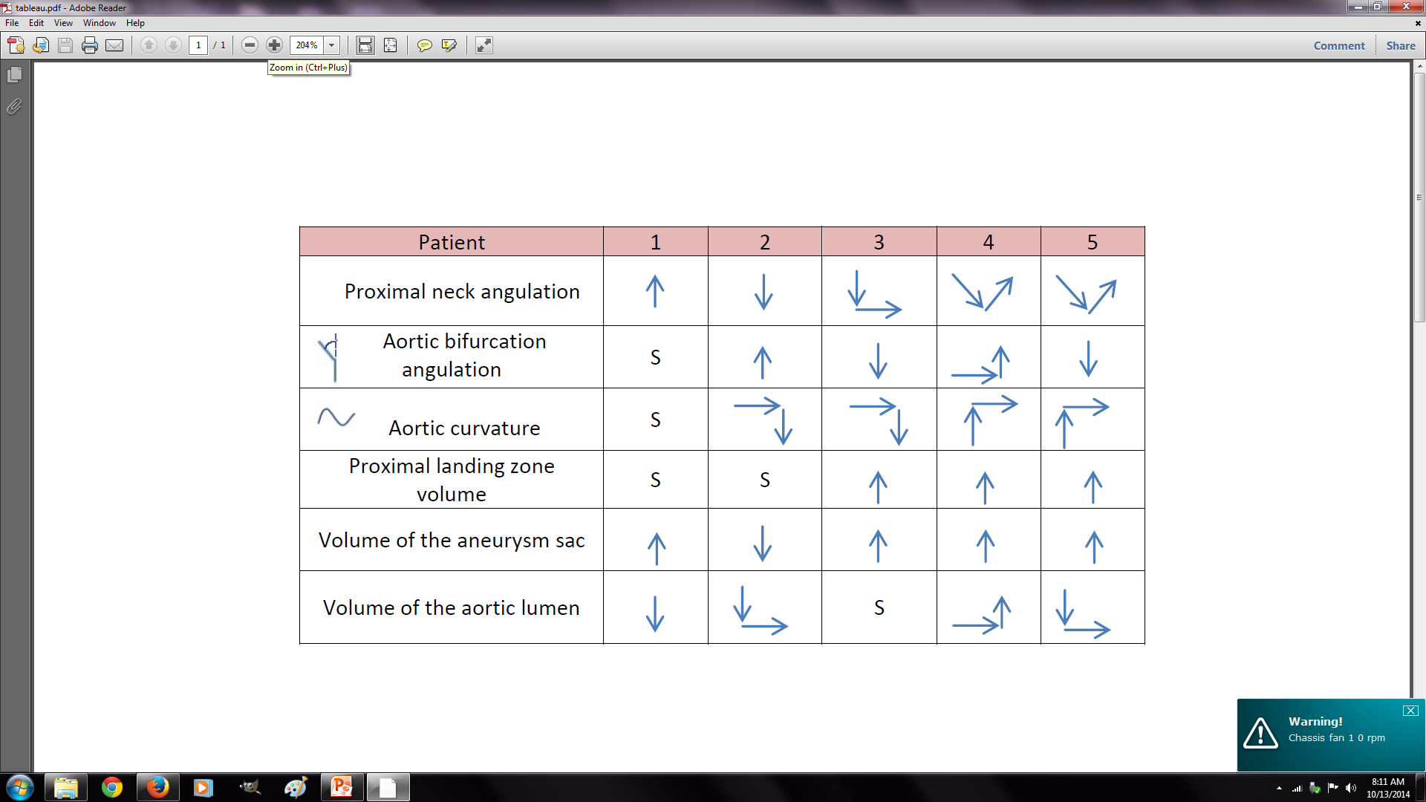
Goal 2 : anatomic data extraction
Patterns of evolution of anatomic features over time (S = stable)
Notes:
The second goal of our project will be to extract relevant anatomic information from these 3D reconstructions.
The first selected anatomical characteristics, based on the literature, were : the proximal neck angulation and volume, the volume of the aortic lumen and of the thrombus, the aortic bifurcation angulation and the curvature of the aortic lumen.
My colleagues could develop an accurate proprietary software in order to automatically extract these data from the 3D reconstructions and the results of the comparison of these data over time for five patients are represented in this table.
We can see that with only five patients, we already have a large panel of different evolutions.
All measures have evolved significantly over time. Look at for example the proximal neck angulation: continuous decreasing or increasing over time, fast decreasing followed by a stable phase, or slow decreasing followed by slow increasing… plasticity is huge.
The evolution of the volume of the sac is important to follow, because its enlargement will be a good predictor of rupture; we see here that we had an increasing enlargement of the sac in 80% of patients.
These results show patterns of evolution, we need to be more accurate and to run our software on many more patients.

Slide 6
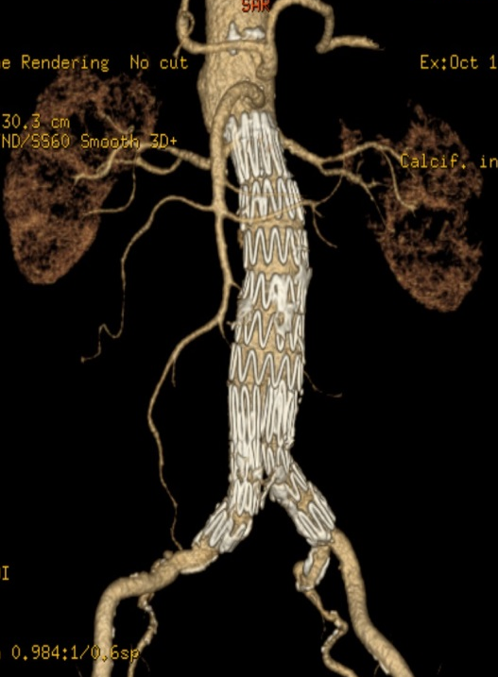
Objectives
Current database : 45 patients with 5 years of follow-up
New definition of the Region of Interest to include renal arteries’ origin and iliac bifurcations
ROI
Notes:
With a collaboration of 3 main hospitals: Strasbourg, Houston and London, we now have 45 patients in our database with a follow up of five years.
We decided to enlarge our region of interest to include the origin of renal arteries and iliac bifurcations in order to also get data about these important regions.
The next step is now to run our software on each pre and postoperative CT scan of the 45 patients.

Slide 7
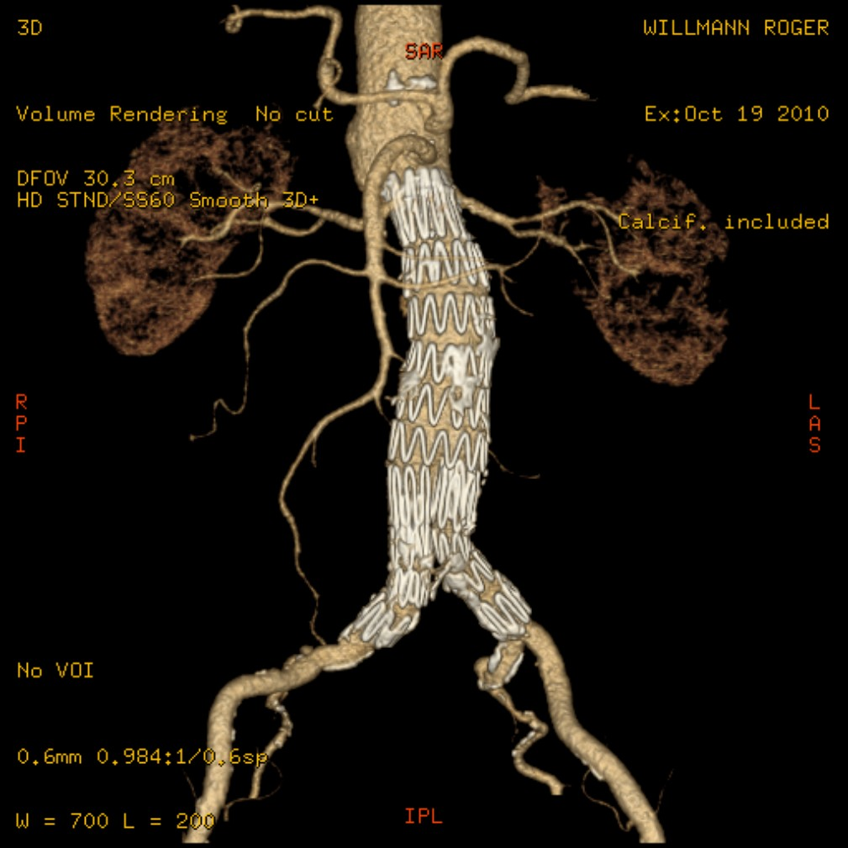
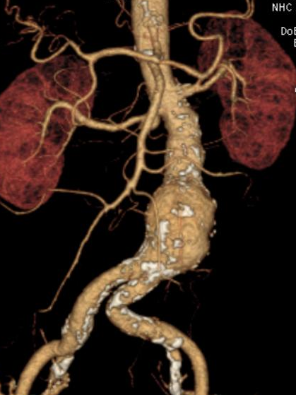
Objectives
New anatomical features improve our software
Length of proximal neck
Length of distal neck
Length of apposition btw artery and stent
Maximal common iliac artery surface
Patent collateral arteries: diameter, precise localization
Presence of type II endoleaks + characteristics
….
Notes:
Furthermore, after discussing with vascular surgeons we added more variables which are important for the follow up, regarding first general anatomy, and also features implicated in specific complications like the type II endoleak, which remember, is the most frequent complication after EVAR.
We will have to improve our proprietary software in order to automatically calculate these measures. We will then compare the results to manual measures made by an expert in order to calculate the numerical error of our code, and run them on our 45 patients.

Slide 8
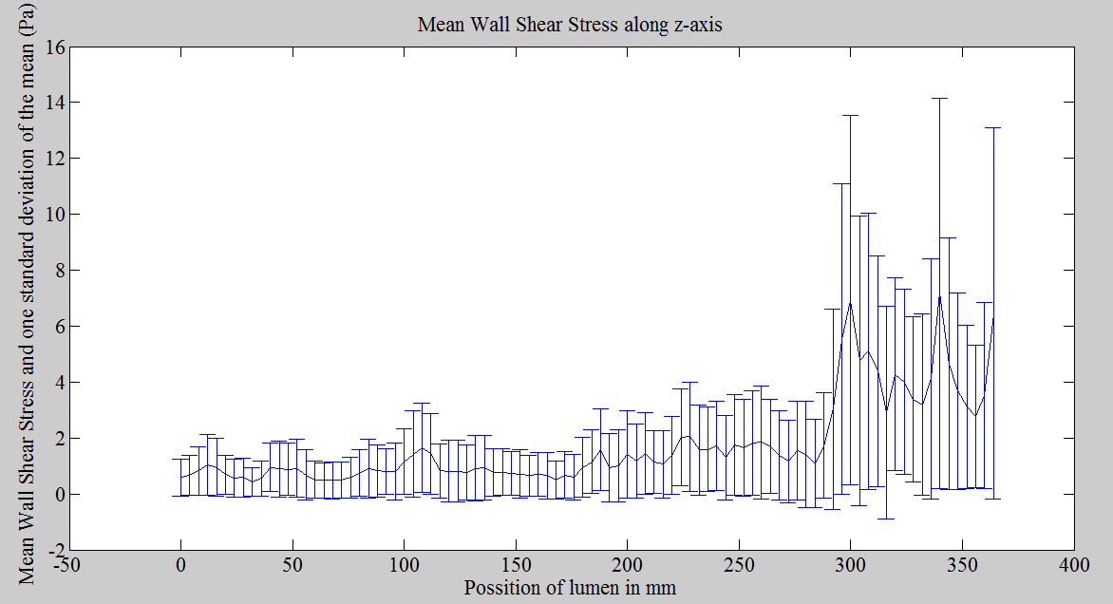
Goal 3 : functional data extraction
Computational Fluid Dynamics Simulation using ANANAS
velocity, pressure, vorticity and wall shear stress
Evolution of the mean wall shear stress along the aorta 1 year after EVAR
Prediction of the evolution of the flow characteristics over time
Simulation of evolution depending on inlet, outlet pressure…
Impact of flow evolution on the endograft : migration, kinking, fracture
Notes:
The extraction of functional data will be extremely relevant in our analysis of the evolution of the interaction between the aorta and the stent, and actually, in the current literature, we practically have no data about that.
We used the software ANANAS which is employed to create simulation profiles and run simulations in order to solve Navier-Stokes equations on 3D models and uncompressible fluids and which can also study interaction btw fluids and structures.
For our first five patients we were able to simulate the velocity, pressure, vorticity and shear stress after the EVAR procedure.
We have here an example of the evolution of shear stress along the aorta 1 year after the procedure, depending on the geometry of the arteries. Imagine you have here your aorta, in an horizontal position, the renal arteries on your left and here the aortic bifurcation.
The next step is to extract these data for each patient, on preoperative CT scans and on every postoperative CT scan.
Depending on the evolution of the aortic geometry, we will be able to predict evolution of the flow characteristics over time and to simulate the evolution by changing some variables as inlet or outlet pressure.
An interesting goal will also be to study the impact of these flow evolutions over time on the stentgraft itself, in order to identify predictors of stentgraft migration, kinking, collapsus or fracture.

Slide 9
Impact of the research on image analysis
Development of a software
  which allows accurate image analysis
  which combines anatomical and functional data extraction over time
  relevant to patient’s follow up after EVAR
Notes:
The main objective of this research program on image analysis is to develop a new software that will be able to
First automatically build accurate 3D aortic reconstruction from CT slides, with the use of adapted aortic segmentation to specific aortic features
Then it should be able to combine anatomical and functional data extraction over time
And this all in order to improve patient’s follow up after EVAR

Slide 10
Goal 4 : Get patients
Current database : 45 patients with 5 years of follow up with yearly CT scan (Strasbourg, Houston and London)
Need for much more
But patient’s follow up is difficult
  CT scan every year or every 2 years
  Old patients with other comorbidities
And yet surveillance is a necessity
Notes:
When we get our software, the last goal of our project, will of course to run it on many patients. As mentionned, our database includes 45 patients so far, thanks to a collaboration btw the hospitals of Houston, Strasbourg ans London.
We need to include much more patients, in order to be significativ.
The problem is that a regular follow up of patients after EVAR, with angio CT scan every 1 or 2 years, lifelong, for old patients with often multiple comorbidities, is harsh.
Even if we know that surveillance is a necessity because of the high rate of long term complications, in these 3 hospitals, after precise data collection, we could notice that the mean percentage of regular follow up was around 30%.

Slide 11
International online database
Why will hospitals enroll ?
  Uploading of yearly CT scans : easy to use, not time consuming for surgeons
  Provide them results about anatomical and functional extracted data of their own patients
  Help them to follow up patients with “reminders” every 1 or 2 years after the last CT scan of each patient
Goal for us :
  Collect data from hundreds of patients all over the world
    Continuous improvement of our algorithms and measure’s software
    Statistical analysis of the results
Notes:
The final goal of this whole project, is to develop an international online database for the follow up of patients after EVAR.
This database will have two objectives:
First help surgeons to follow up their patients. It will be an simple interface, easy to use, where they will just have to upload the CT scans of their patients and enter few general data. Once the analysis is performed they will have access to every result concerning their own patients: results of the anatomical and functional extraction, and comparison over time.
Furthermore, we will include an « alarm function » which will automatically address reminders to the surgeons each pre-determined interval after the last CT scan.
The second objective will be for us to collect data from hundreds of patients all over the world; to analyze them, and to continuously improve the algorithms and measure’s codes.
Third objective? E-learning?

Slide 12
Global Impact
Better understanding of interaction between aorta and stentgraft, regarding anatomic and functional features
Improve knowledge about poor issues after EVAR
Identify new anatomical and functional risk factors of complications
Improve EVAR indications
Help industries to improve following generations of stentgraft
Give surgeons tool to improve patient surveillance

Slide 13
Project duration / Budget
First year : run all the process (anatomic and functional extraction) on the 45 patients, include new measures in our proprietary software :
early results
Following years : continuous enlargement of the international database and data analysis
Budget : 50K
  PhD in CFD and computer science
  Analysis study
  Web developer
  Promotion of the online database

Slide 14
Thank you
Questions ?
Please complete LIFE form at : www.iucrc.com

